Slide 1



BLOOD BANK DATABASE MANAGEMENT SYSTEM
Project by:
Ruqhaiya Syeda
Siva Sushmitha Meduri
Janani Krishnamurthy
MS Data Science - TEAM 02-02

Slide 2
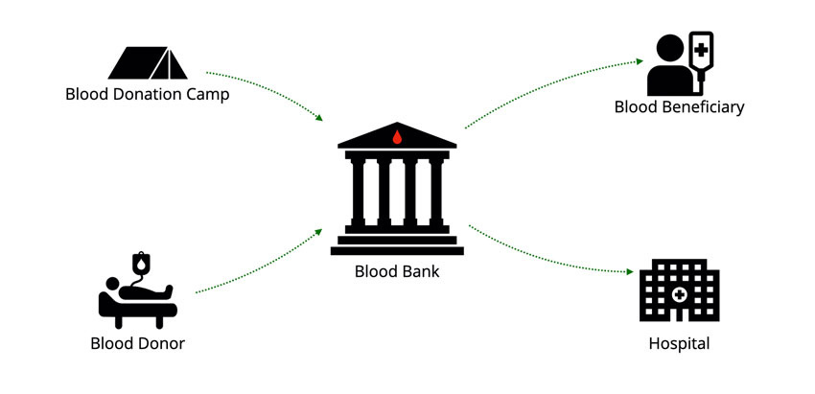
Mission Statement
Our mission is to develop a specialized Database Management System for blood bank management, aiming to streamline the donation process, maintain optimal blood inventory levels, and ensure swift access to blood for hospitals and emergency services. This project presents an exciting opportunity to merge technology with a critical healthcare cause, potentially accelerating life-saving blood distribution. Beyond managing data, it's about creating impactful change and deepening our expertise in data security and backend development.

Slide 3

Challenges Faced by Blood Banks
Manual record-keeping: Traditional paper-based systems are prone to errors and inefficiencies.
Inventory management: Difficulty in tracking blood donations, expiry dates, and inventory levels.
Donor management: Managing donor information and ensuring a consistent donor pool is challenging.
Blood compatibility: Accurate matching of blood types and screening for infectious diseases is critical.
But, How do we overcome these problem ?

Slide 4


Introducing the Blood Bank Database Management System
Blood banks are vital healthcare facilities. A streamlined database system is crucial for managing inventory, donor data, patient records, and ensuring safe and efficient blood transfusions.
The BB-DMS is a comprehensive software solution designed to address the challenges faced by blood banks.
It offers a centralized platform for managing all aspects of blood bank operations efficiently.

Slide 5
Blood Bank Management System Key Features -Tables
Entities | Description
Blood | Represents the actual blood units collected from donors. It includes details like blood type, quantity, collection date, expiry date, and links to the donor who provided it. It also indicates whether the blood has been tested.
Donor | Represents individuals who donate blood. This entity stores personal and contact information, blood type, health history, and other relevant details about the donors
Blood Request | Represents the requests that the blood bank gets from different hospitals.
Employee | Represents the employees details of the blood bank
DonationCamp | Represents the details of the blood donation campaigns and medical details.
Entities | Description
DonationEntry | Represents all the donations made by the blood bank to hospitals and donations made by the donors to the blood bank
Hospital | Represents healthcare facilities to which the blood bank supplies blood. This entity is crucial for managing and tracking the distribution of blood to various hospitals, ensuring that the blood bank efficiently meets the demands of these healthcare institutions
Recipient | Refers to individuals who receive blood. This entity includes their personal information, the type of blood needed, and specific medical conditions that necessitate the blood transfusion.

Slide 6
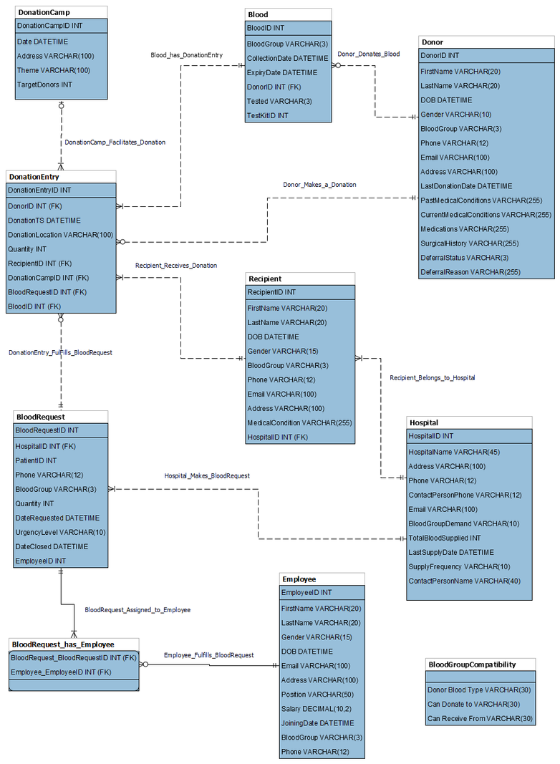
ER Diagram

Slide 7
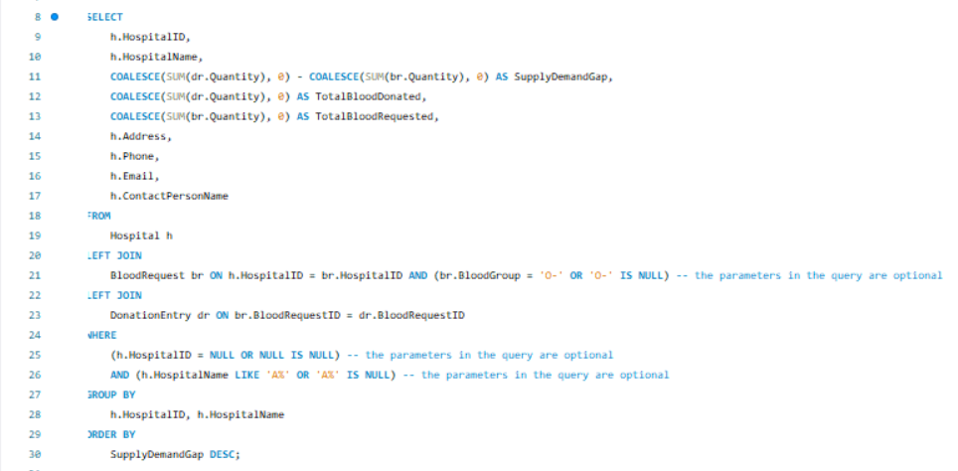
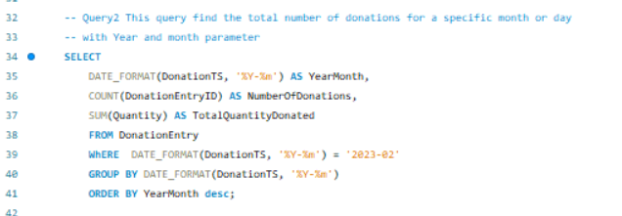
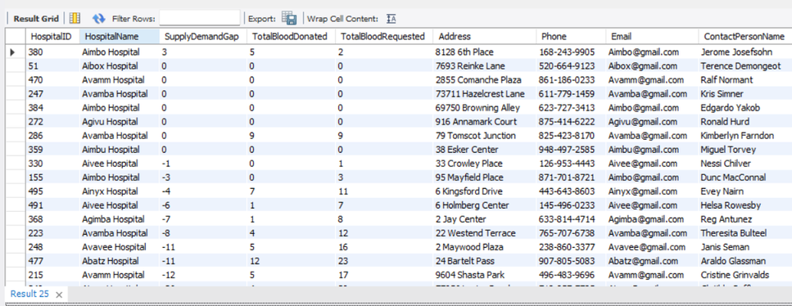
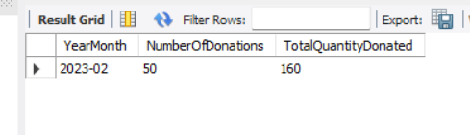
Queries and Stored Procedures
Our project incorporates essential components such as many queries and two stored procedures to enhance the functionality and efficiency of the Blood Bank Database Management System (BB-DMS)
Query: Calculates Blood Supply Vs Demand for each hospital
Query: Shows total donations and quantity of blood donated
Output
Output

Slide 8
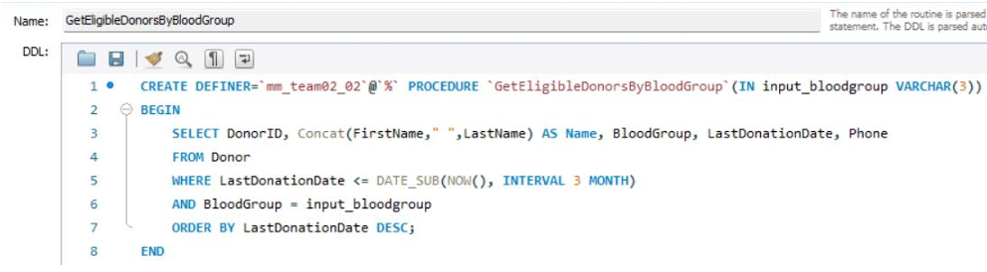
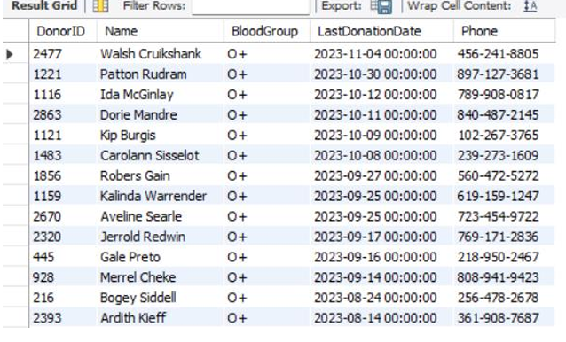
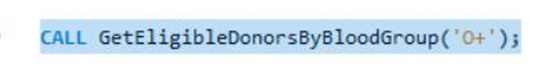
Stored Procedure : GetEligibleDonorsByBloodGroup - This stored procedure gets the eligible donors for a particular blood group which is given as an input.
Output
Calling the Stored Procedure

Slide 9
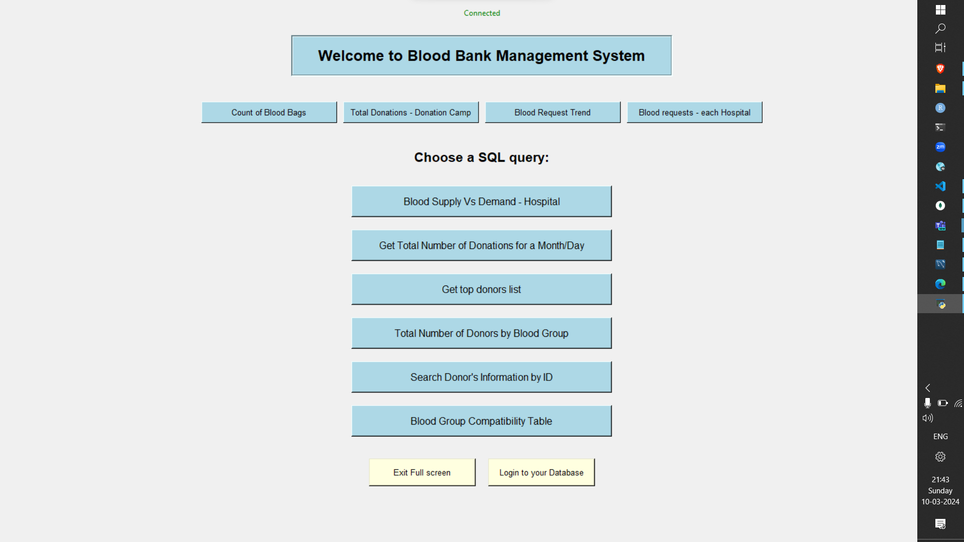
GUI for the Blood Bank management database
Built using Object Oriented Programming

Slide 10
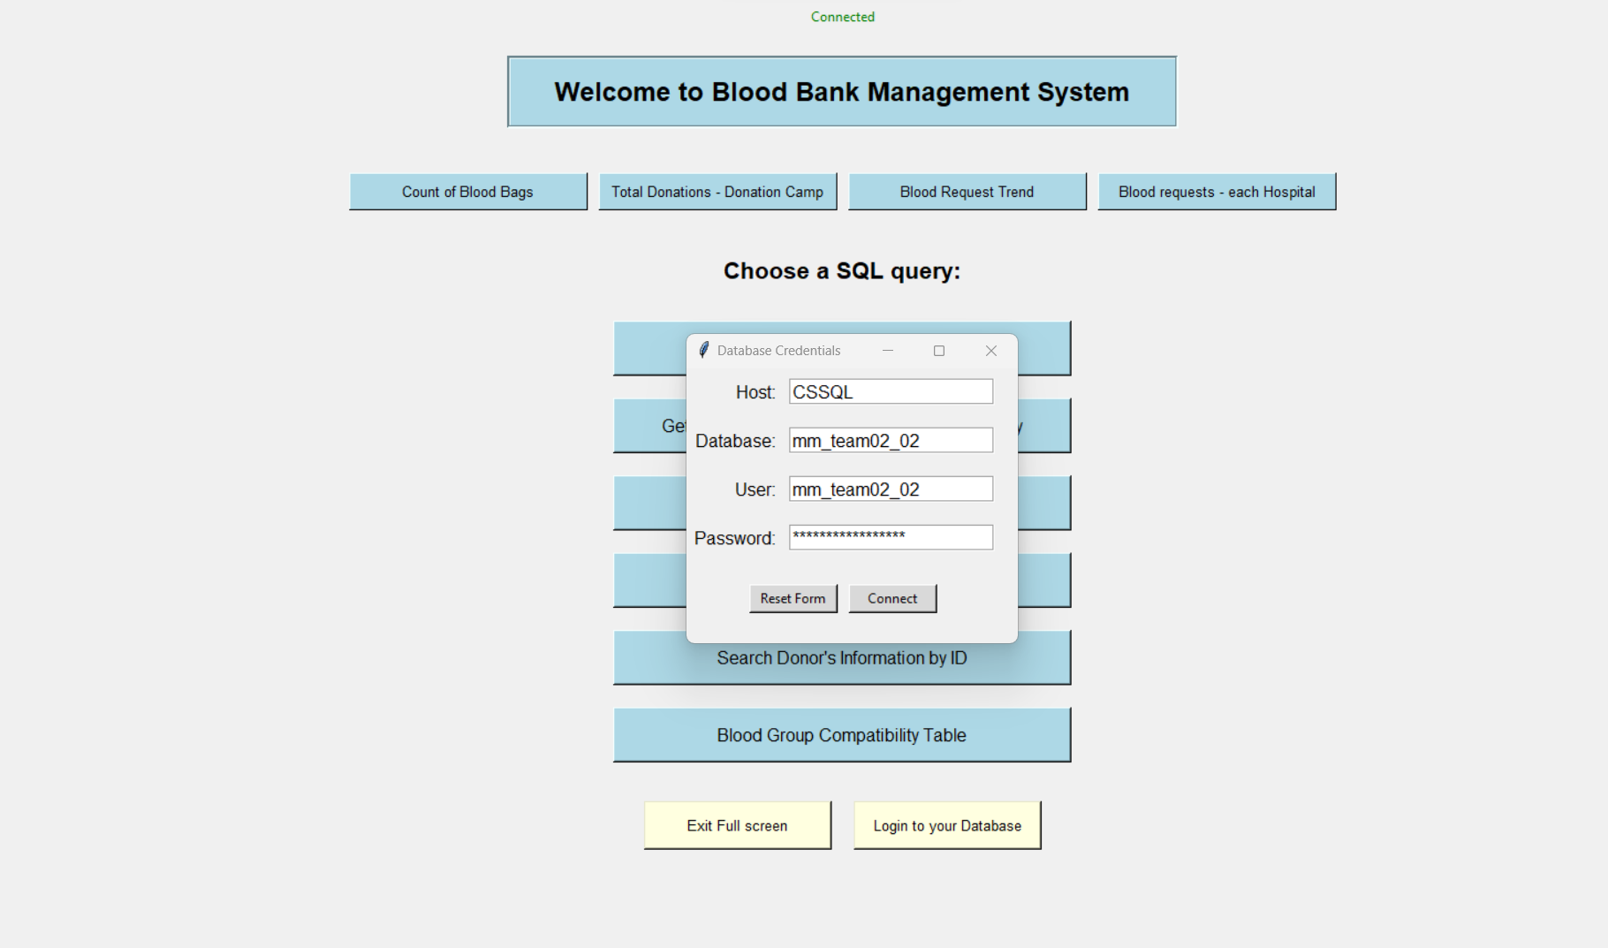
GUI for the Blood Bank management database

Slide 11
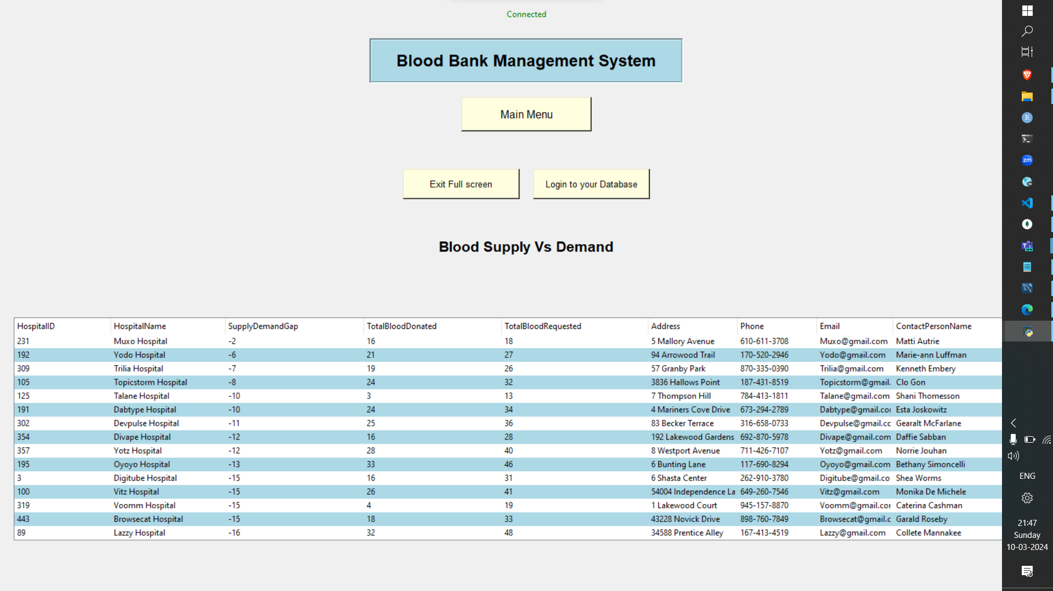
GUI for the Blood Bank management database

Slide 12
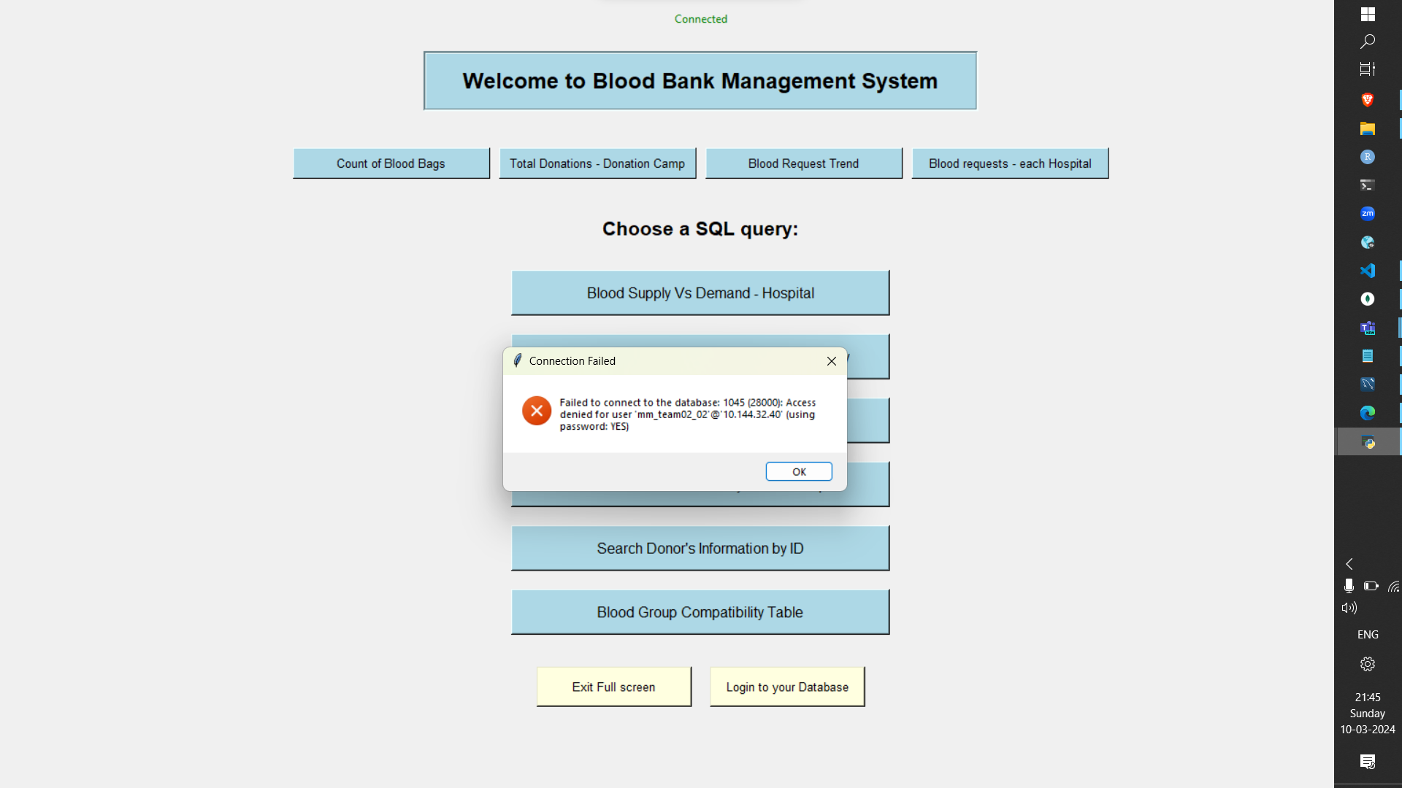
GUI for the Blood Bank management database

Slide 13
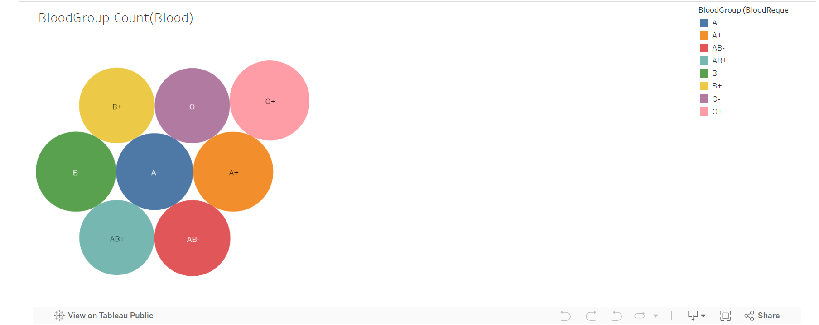
Tableau Visualizations
Total blood collected from each blood groups

Slide 14
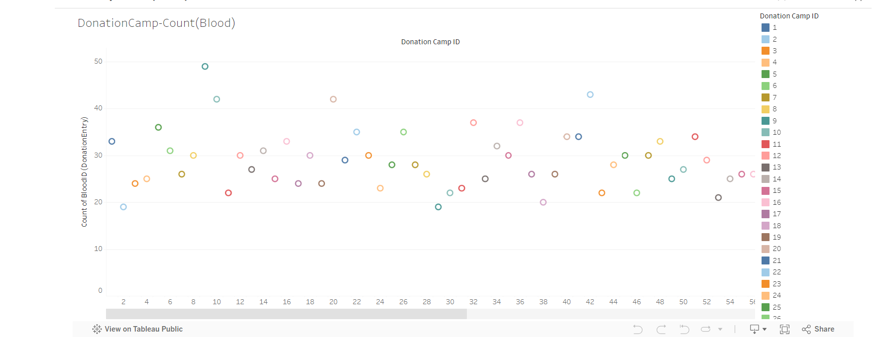
Donation camps analysis

Slide 15
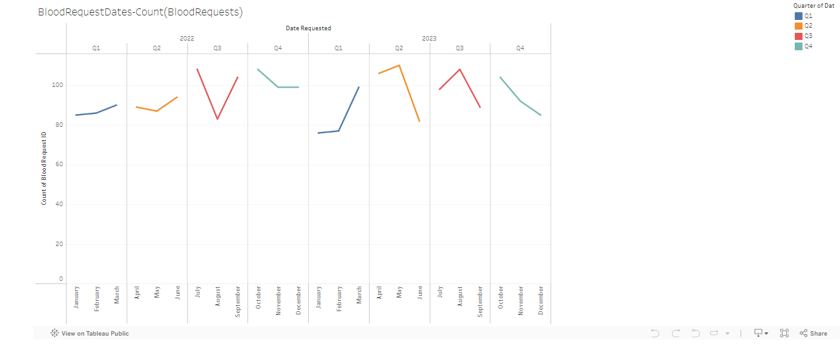
Blood requests trend on 2022-2023

Slide 16
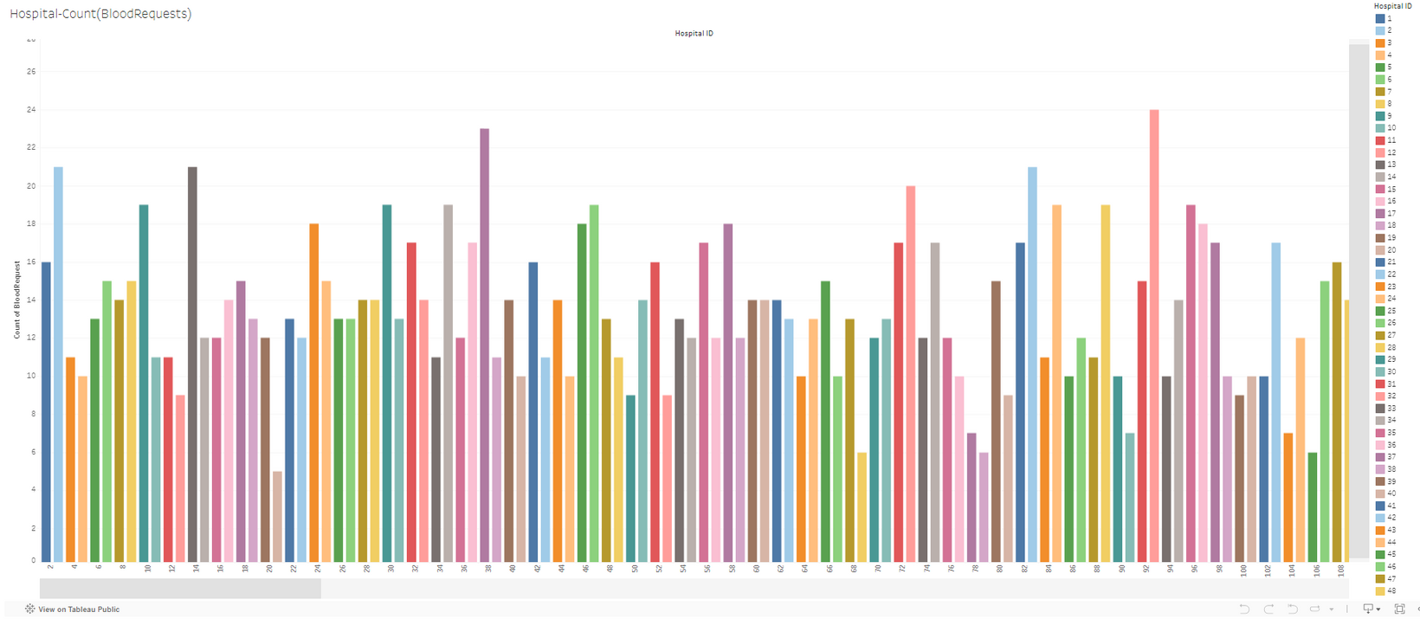
Visualization of Blood Requests from different Hospitals

Slide 17
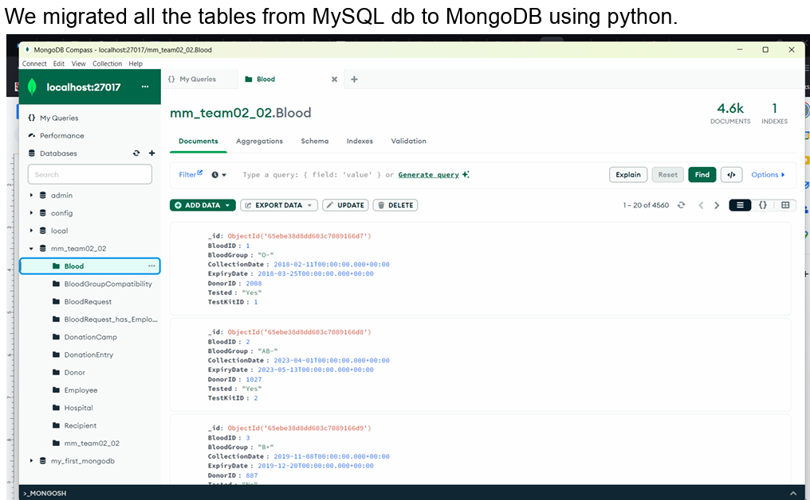
Additional Features

Slide 18
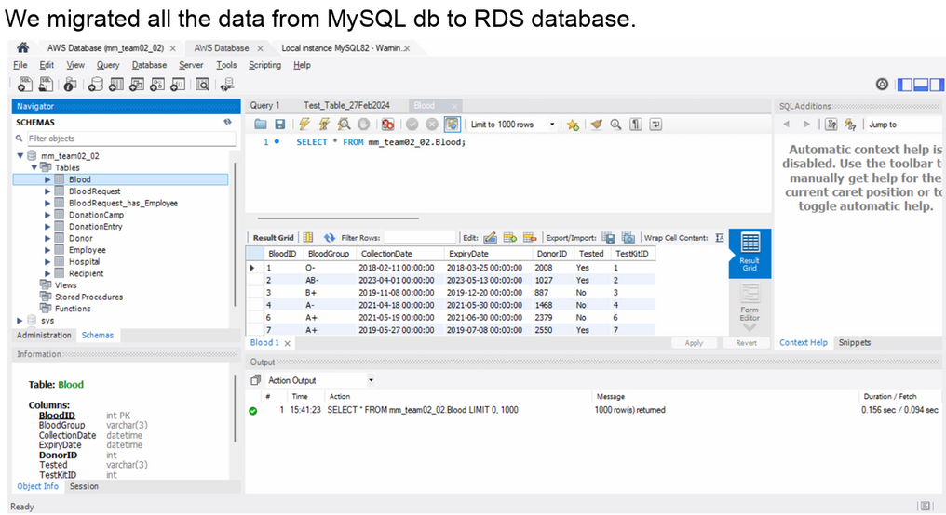

Slide 19
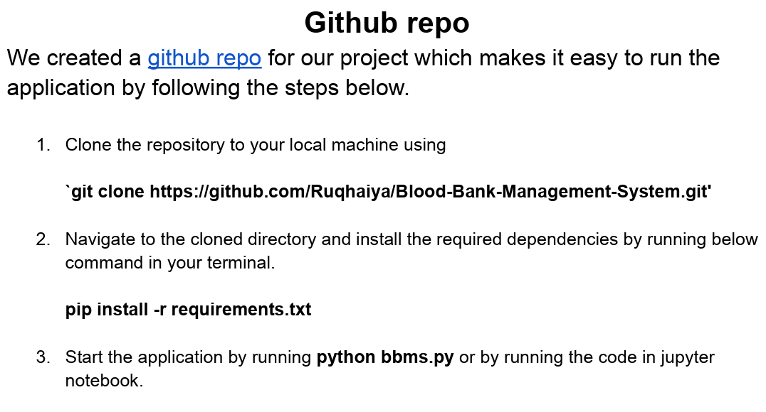
link

Slide 20
Lessons Learnt
'Divide and conquer' tasks: We learnt how to divide and manage tasks, it helped us getting things done faster.
We communicated effectively about goals and expectations.
We realised that error handling in code is an essential thing which makes life easier.
We learnt a lot from each other and will carry this experience forward for future projects.

Slide 21

Thank you

